Slide 1
Sereniiti project – Bert Model
Ayman Sharara – SPOC – S21

Slide 2
Objective: Creating a model that classify NVC compliant on text given by a user.
4 tasks, provided by a state of art BERT Model.
Rating the level of compliance with NVC
Classify the sentence according to the step it shall be inside.
Classify the sentence according to the tip.
Classify the sentence according to the tips groups.

Slide 3
BERT model implemented on TensorFlow on Collab Notebooks

Slide 4
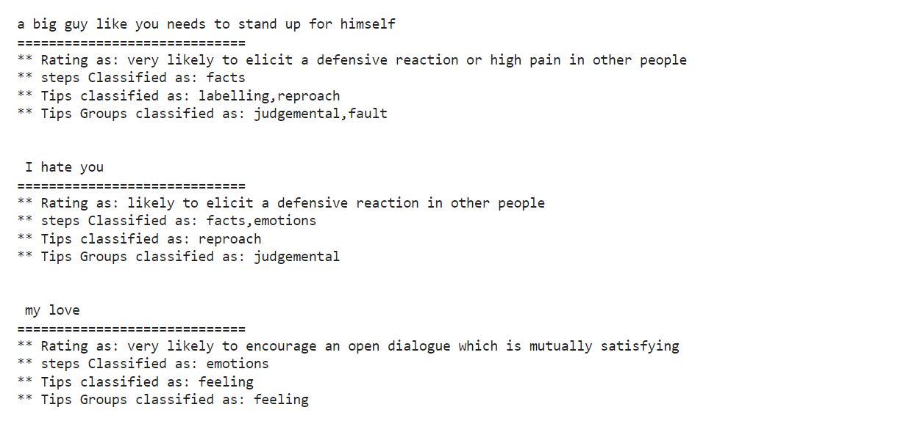
Text classification result for the below sample
a big guy like you needs to stand up for himself, I hate you, my love

Slide 5
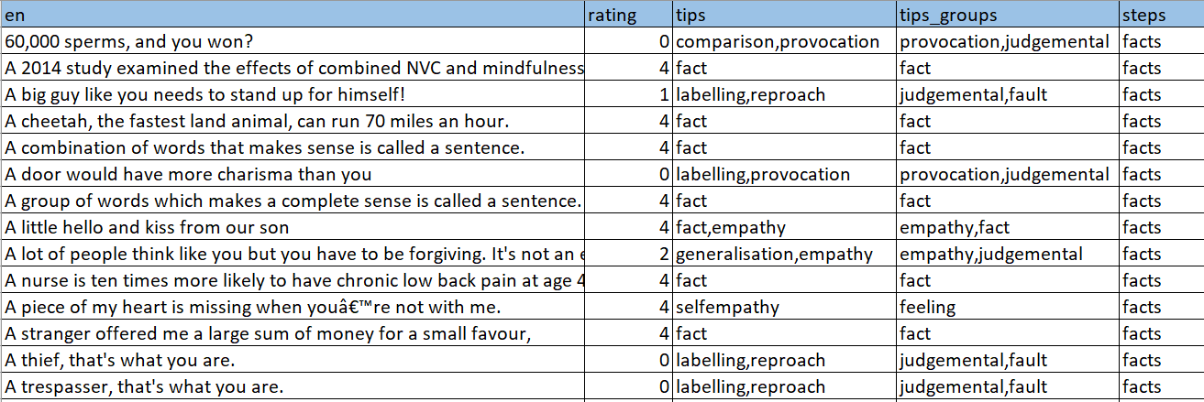
Data set sample

Slide 6
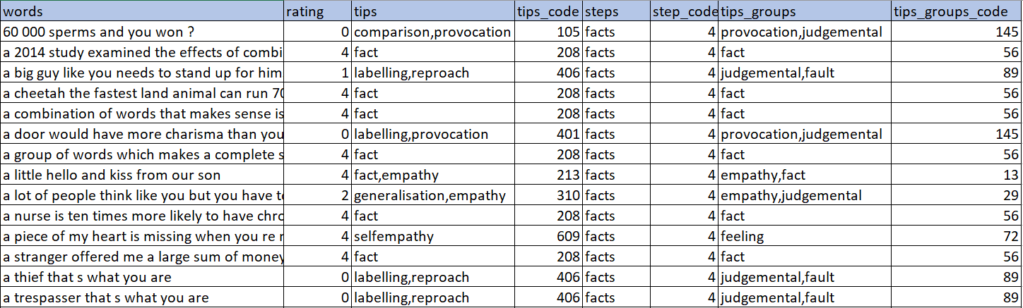
Data set after preparation

Slide 7
Bert model training function

Slide 8
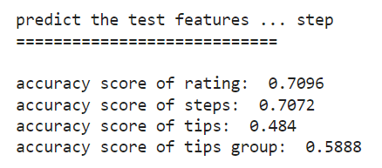
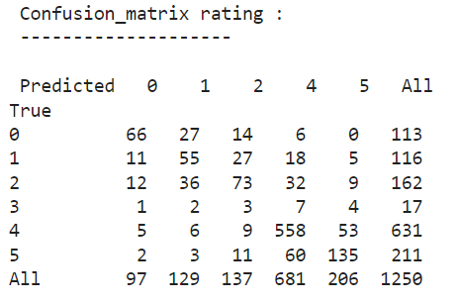
Accuracy score & Confusion matrix with applying on 5000 record only of the dataset
All details in the blow notebook
https://colab.research.google.com/drive/1ntt1eqzouYeUhPs2sXihEqwLIIwjwfl2?usp=sharing

Slide 9
Prediction function

Slide 10
Demo step function – input text and classify

